Slide 1
Topic: Technology does help the poor and disadvantaged.
Group Name: NASAM

Slide 2
Group Members
Idea producer and responsible for content review
Steven Bondaruk
basic descripsion
Video Editor
Andrey Yamkovoy
basic descripsion
cooperative teamates!
Power Point Maker
Minjuan Luo
Responsible for the distribution of team members and give suggestions to the group.
Respinsible for Conclusion part
Naveen Senthil Kumar
basic description

Slide 3
Basic Content
1
2
3
Simple Statement
Tools and Equipment
Opportunity
we decided to against the topic because......…
Speech by
Steven Bondaruk
Speech by
Andrey Yamkovoy

Slide 4
4
5
The End
Improve Social Influence
Conclusion
Spech by
Minjuan Luo
Speech by
Naveen

Slide 5
Simple Statement
01
we against it...

Slide 6

Group Opinion
As a group, we have collectively agreed that we believe the technology does help the poor and disadvantaged.

Slide 7

Why choosing against it then?
The progress of science and technology has created huge material wealth and spiritual wealth for mankind.
With the advent of the era of knowledge economy, the endless development of science and technology and its unlimited creativity will certainly continue to make greater contributions to human civilization. Which means The development of science and technology can allow mankind to reach common prosperity earlier.
All in all, the unlimited future of technology pushes us to believe it can actually do well for all human including disabled and disadvantaged.
reasons...

Slide 8
Tools and Equipment
02
Speech by Steven Bondaruk

Slide 9

Overall Opinion
'I think It does help the poor and disadvantaged, but it depends what technology you bring to the country and how you use them’.

Slide 10
Clean Water
one good example provided
1.Access to clean water is one of the most common problems in the poor and disadvantaged countries.
2.Over 1 billion people in the world do not have access to fresh water. So in simplicity, funding and investment on water pumps can be made.

Slide 11
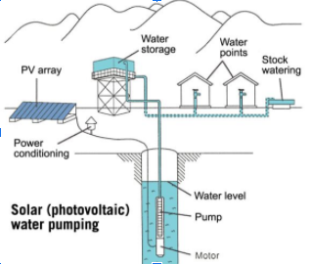



Clean Water
Practical Action
Design
Build
Launch
1.For example partnered with Kenyans from the Turkana region to set up water pumps in their dry villages.
2.According to the organisation, they have developed a solar-powered water pump
3.Using its locally-sourced equipment to pump 30,000 clean litres of water to the village every day.

Slide 12

Transportation
Practical Actions
1
2
3
4
Distance
medical emergencies
Connect
Bicycle transport
Many poor villages live very far away from the large towns so trips for food and water can take hours.
Similarly with medical emergencies, they simply can’t make it to the hospital in time.
Geometry arose independently in a number of early cultures as a body of practical…
Plenty of villagers have bicycles but they won’t be able to transport the resources or the ill easily.

Slide 13
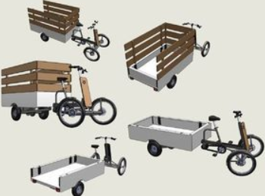
Transportation
So Practical Action worked with the villagers to build bicycle trailers that are able to transport up to 200 kilograms of passengers or resources.
Even as simple of a creation as a bicycle trailer can have the potential to save thousands of lives.

Slide 14
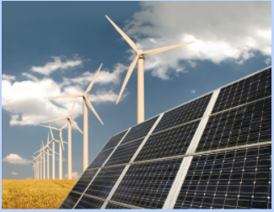
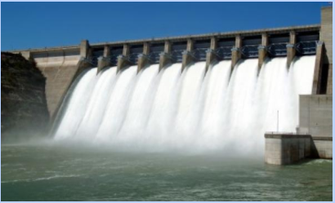
Sustainable Energy
solar, wind and hydro power
way out of poverty
energy resources
Simple technologies
Access to energy is what enables people to be able to work their way out of poverty, improve their living conditions and access to other services like education.
With new technologies that we have today such as solar, wind and hydro power, can provide access to those types of energy resources without requiring to build expensive power plants.
Simple technologies like fire-less cookers that rely on stored heat can save time and money in every family.

Slide 15
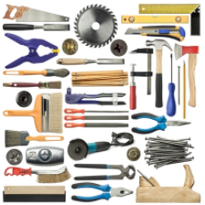
General Tools
efficiency and the effectiveness
currently in poverty
production
Regardless what village that is currently in poverty, it can be alleviated as simple as providing the proper tools.
Tools are the main things that are used to improve efficiency and the effectiveness of production.
farm tools
building tools
farm tools and equipment are used to improve farming efficiency
building tools that improve the efficiency and effectiveness of construction of buildings and shelters.

Slide 16

General Tools
Some villages just simply don’t have those tools. If the tools were to be provided to them and taught how to use them, they can improve their condition by themselves without even requiring constant support and assistance from the organization that helps to provide the tools.

Slide 17
General Tools
Some villages just simply don’t have those tools. If the tools were to be provided to them and taught how to use them, they can improve their condition by themselves without even requiring constant support and assistance from the organization that helps to provide the tools.

Slide 18
General Tools
Some villages just simply don’t have those tools. If the tools were to be provided to them and taught how to use them, they can improve their condition by themselves without even requiring constant support and assistance from the organization that helps to provide the tools.

Slide 19
General Tools
Some villages just simply don’t have those tools. If the tools were to be provided to them and taught how to use them, they can improve their condition by themselves without even requiring constant support and assistance from the organization that helps to provide the tools.

Slide 20

Conclusion
my thoughts...
In conclusion to this topic, tools and equipment definitely improve the living conditions for the poor and disadvantaged. Any simple technology that is provided can help to alleviate poverty by a good step.

Slide 21
Opportunity
3
Speech by Andrey Yamkovoy

Slide 22
My Opinion
thoughts...
Technology does help the poor and disadvantaged by providing them with opportunities to do more and accomplish more of their goals and aims.

Slide 23
Technology provides opportunities for work when new, to rise from poverty.
This is often the case with countries or areas that have a lower Gross National Income.
(Personal Anecdote)
Gross National Income
/ saviour to job crisis
For example, through the opportunity provided of learning to program and use new technologies and getting higher-paying jobs, my parents gathered enough wealth to rise from poverty and move to Ireland.
Personal Example

Slide 24
Access to Education
Technology provides not only the rich but also the poor access to education and connection to their families even when separated due to unfortunate reasons.

Slide 25

At this time simple technology like phones and laptops are invaluable to people of less wealth as they are easy to use,don't require a lot of space and have all the tools necessary for online learning.
This is easily noticeable during the current crises where many students are learning from home on their technology.

Slide 26
Technology provides a way to be heard.
Generally, many problems are not thought of due to ignorance.
hear and know
online platform
Mental health
Technology helps the problems of the poor and disadvantaged be heard and known about.
Through the use of online platforms, it is far easier to get in contact with helplines and let people know about the problems that are currently happening.
It is also helpful for people's mental health to be able to be heard and have somewhere to vent and get help to deal with different problems.

Slide 27
Technology can reduce the cost of expenses due to technology helping the production of goods and services.
Transportation
E.g
For example, the service of transportation costs less, making it more available as it is easier to accomplish due to the help of technology.
Example
E.g Cost of flights is far lower than previously.
Opportunities
The cost of public transport goes down due to its effectiveness in transporting large amounts of people thus making it available to those of lower income.

Slide 28
Technology provides physically disadvantaged people with many opportunities
they want to continue living
and how they can solve the physical problems that they encounter.
E.G
E.G
Artificial limbs
creation of new medicines for previously incurable illnesses.

Slide 29
Conclusion
my thoughts
In conclusion, technology helps the poor and disadvantaged by providing them with countless more opportunities to improve their conditions and help with problems.

Slide 30
Improve Social Influence
4
speech by Minjuan Luo

Slide 31
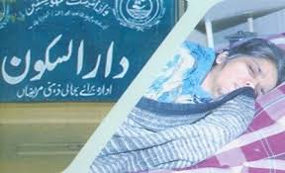
Welfare Institution
a glimpse to history
Nowadays, the rich are more willing to help the poor by setting up a welfare institution.

Slide 32


Why?
1.This will not only help the rich avoid paying tax but also improve social influence due to the extremely high development of news media.
2.The pressure from public opinion will force the rich to set up welfare institutions in order to improve social credibility, which provides the poor a better environment to live on.
It seems much more difficult to see a rich man donate money to the poor spontaneously in the past.

Slide 33
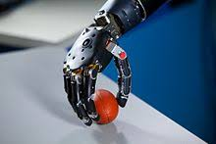
Man-Made Organ
The disabled group is one big part of the disadvantaged people. They always suffer from the discrimination from others and can’t apply for any high-paying occupation to work.
However,the invention of manufactured eyes, legs and so on provide those disabled people opportunities to contribute to society and even a chance to live a better life.

Slide 34

Big Data Era
Nowadays, the government and administrators are becoming more and more dependent on collecting data from the whole society in order to get the most accurate result that can reflect the citizens’ opinion,
which gives the disadvantaged opportunity to speak for themselves.
LACK OF VOICE
The main function of the big(giga) data era is that it can help the society more focus on the group of people who are LACK OF VOICE(disadvantaged).

Slide 35

Internet Development
The invention of the internet provided people who are disadvantaged a place to share their experience and ideas.
There are so many famous platforms in the present like twitter, instagram that any of us can show our special lives,
which means people of low social status can speak for themselves there when they face some unfair treatment.
It will very likely become widely concerned by society if someone is lucky. This was impossible back in the 20th century period.

Slide 36
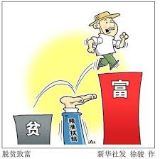
Poverty alleviation
With the continuous development of technology, online shopping is becoming more and more influential in the world.

Slide 37
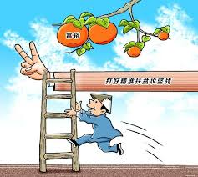
Poverty alleviation
With the goal of targeted poverty alleviation, Chinese communist decided to make good use of online shopping. This virtual shopping platform provides business opportunities for people who can not sell their products in the past due to living in distant villages.
Citizens nowadays prefer to go shopping by a single computer and wait for the delivery to send those products they want. This provides a path to wealth for the people who live in the remote mountains in China for example.

Slide 38
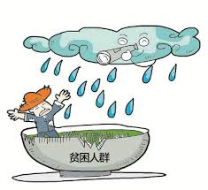
Poverty alleviation
It’s some kind of powerful advertisement too as people nowadays are getting more and more willing to eat organic agricultural products instead of greenhouse plants. In terms of the results, it was a great success.

Slide 39
Final Conclusions
05
Speech by Naveen

Slide 40
Conclustion Part
Base on others opinion
The assignment has detailed the importance of technology in bringing advancement of the poor and disadvantaged sector of the society. It has identified the aspect that with the help of technology human beings have been able to gain huge material wealth and spiritual wealth for mankind. Thus, the development in science and knowledge can be beneficial to the diasbled and the poor sector of the society.

Slide 41
Conclusion Part
base on others opinion
Amazing Slides
In the context of poor and disadvantaged countries, the water crisis is said to be the most important challenge for them. There is a large part of the world’s population that does not have proper sanitization and freshwater. However, this assignment is of the opinion that with the help of advanced technology it will be possible to gain proper access to clean water. Technologies can help the poor and disabled sector of the world’s population to gain proper sanitization and healthy water for their day-to-day usage.
Pixel Perfect Design

Slide 42
Conclustion Part
Base on others opinion
Increased investment has to be made in water pumps, irrigation, wells, water tanks and others can be made. In this context, this assignment has described ways in which practical actions can be taken for improving the water management facilities in these areas. It has highlighted ways in which Kenyans have set up water pumps in their regions.

Slide 43
Conclusion Part
base on others opinion
Amazing Slides
On the other hand, there are numerous companies and governmental bodies in different developing countries which have built solar powered water pumps. Along with using the local sourced equipment, regions have also built clean water resources for the people around those regions.
Pixel Perfect Design

Slide 44
On the other hand, there are numerous companies and governmental bodies in different developing countries which have built solar powered water pumps. Along with using the local sourced equipment, regions have also built clean water resources for the people around those regions. However, this assignment has pointed out that enhancing the transportation facilities are highly necessary. Along with this, medical emergencies are also to be considered while designing and implementing the water requirements of the regions.
Conclusion Part
base on others opinion
In this context, this assignment has highlighted that with the help of technology, these countries, governmental bodies and other companies, private investors have been able to use geometry and other tools as practical application methods for helping these regions.

Slide 45
Another challenge of the poor and disadvantages portion of the society is sustainable energy resources. Sustainable power resources such as solar power, wind power and hydro power have been capable of improving the quality of lives of these people. This assignment has pointed out that technology is the only way out of poverty as it helps to provide them with education and other facilities for their overall development.
Conclusion Part
base on others opinion
On the other hand, sustainable power resources have helped in building expensive power resources. This assignment has also pointed out that technology has advanced yet become highly flexible and fast moving. Technologies like the fireless cookers or other small yet highly flexible technologies helped household members, office goers, government and other sectors of the society.

Slide 46
Conclustion Part
Base on others opinion
This assignment thinks that the root of resolving issues and challenges of the backward sector of the societies are to determine the proper kinds of tools and techniques. While the farm tools can improve the irrigation facilities, production tools like effective supply chain management, lean production facilities, robotics and others can also improve the efficiency and the effectiveness of the production functions.

Slide 47
Conclusion Part
base on others opinion
Amazing Slides
On the other hand, building tools can also be used for improving the effectiveness of the building construction, quality project management, risk identification and mitigation strategies. However, the assignment has highlighted that the majority of the people do not have proper access to these tools. These people do not have the adequate resources or the knowledge base to effectively use these tools and techniques.
Pixel Perfect Design

Slide 48
Due to this reason, it is required for the companies and other stakeholders to provide essential support and assistance to these people. These people have to be educated regarding the aspect that technology can reduce the expenses and improve the quality of goods and services provided.
Conclusion Part
base on others opinion
It has been stated that technology can reduce the cost of public transport, it can also reduce the cost of flights and optimize the use of other functions and sub functions. New doctors and researchers are trying to introduce technology to medical facilities. These people have already started to use technology for treating patients.

Slide 49
Artificial limbs and other parts of the body are being created to help the disabled people. This assignment has also stated that technology can be introduced in welfare institutions to improve social influence.

Slide 50
It is said to improve social credibility and the standard of living of the poor and backward section of the society. Thus, this assignment has been able to establish the importance and contributions of technology in creating a better society for the weak and disabled people.

Slide 51
Diary Part

Slide 52
Steven: Researched on the topic of tools and equipment and how they can actually improve the living conditions and the overall quality of life. The main parts that were researched were, 1.How the clean source of water is probably the most essential thing that everyone needs and how the problem can be solved for those that don’t have a reliable and safe source of water. 1.How the mode of transportation within the country can be very poor and how it can be improved by a good margin without investing much money and resources. 1.How some countries don’t have access to a sustainable source of energy and how investing in them can improve the overall living conditions and produce essential services. 1.How some countries may even lack basic tools that affect the efficiency and productivity of the country. The overall conclusion to this topic with a bit of a Q & A with the other members based on the topic.

Slide 53
Minjuan Luo: Researched on the topic of Improve Social Influence and find out how technology can make an influence to the social class and social phenomenon. The main parts that were researched including, 1.How technology influenced the rich to set up welfare institutions and did a great help to the poor. 2.Why the rich can get benefits from donating money nowadays. 3.How the man-made organ was designed and what is the usage of them. 4.What changes may happen if the disabled equip those man-made organs. 5.How the people who are Lack Of Voice seize their opinion and use technology ,internet to speak for themselves. 6.How China makes good use of technology and figures out a good way to execute poverty alleviation. The overall conclusion to this topic with a bit of a Q & A with the other members based on the topic.

